Slide 1
Homework 2

Slide 2
Homework 2
Subject :
Silhouette coefficient
Description
The silhouette value is a measure of how similar an object is to its own cluster (cohesion) compared to other clusters (separation).
Cluster Cohesion: Measures how closely related are objects in a cluster
Cluster Separation: Measure how distinct or well separated a cluster is from other clusters
In this homework, you need to implement it.
Cohesion
separation

Slide 3

Homework 2
Silhouette coefficient
a(i) : the average dissimilarity of i with all other data within the same cluster
b(i) : the lowest average dissimilarity of i to any other cluster
$$s\left(i\right)= \frac{b\left(i\right)−a(i)}{max⁡\{a\left(i\right),b(i)\}}$$

Slide 4
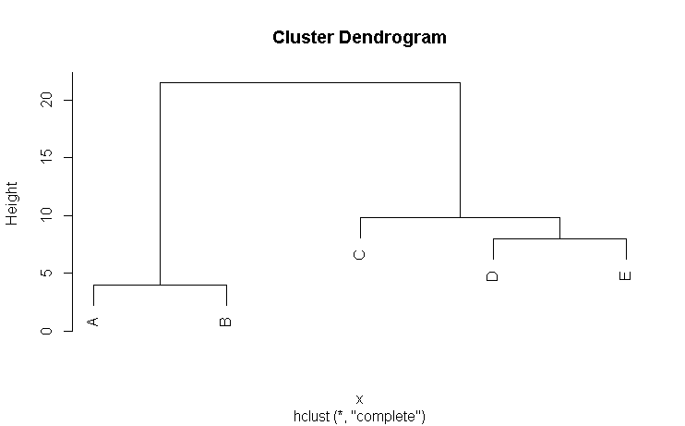



Homework 2
Example 1:
Cut threshold : 15
Cluster 1 : A, B
Cluster 2 : C, D ,E
 | A | B | C | D | E
A | - | 4 | 11.7 | 20 | 21.5
B | 4 | - | 8.1 | 16 | 17.9
C | 11.7 | 8.1 | - | 9.8 | 9.8
D | 20 | 16 | 9.8 | - | 8
E | 21.5 | 17.9 | 9.8 | 8 | -
$a\left(A\right)=4$
(the same cluster)
$b\left(A\right)=(11.7+20+21.5)/3$
(to any other cluster)
$$s\left(A\right)= \frac{b\left(A\right)−a(A)}{max⁡\{a\left(A\right),b(A)\}}=\frac{17.733−4}{17.733}=0.7744$$

Slide 5



Homework 2
Example 1:
Cut threshold : 15
Cluster 1 : A, B
Cluster 2 : C, D ,E
 | A | B | C | D | E
A | - | 4 | 11.7 | 20 | 21.5
B | 4 | - | 8.1 | 16 | 17.9
C | 11.7 | 8.1 | - | 9.8 | 9.8
D | 20 | 16 | 9.8 | - | 8
E | 21.5 | 17.9 | 9.8 | 8 | -
$a\left(D\right)=(9.8+8)/2$
(the same cluster)
$b\left(D\right)=(20+16)/2$
(to any other cluster)
$$s\left(D\right)= \frac{b\left(D\right)−a(D)}{max⁡\{a\left(D\right),b(D)\}}=\frac{18−8.9}{18}=0.5056$$

Slide 6





Homework 2
Example 1:
Cut threshold : 15
Cluster 1 : A, B
Cluster 2 : C, D ,E
$$s\left(A\right)= \frac{b\left(A\right)−a(A)}{max⁡\{a\left(A\right),b(A)\}}=\frac{17.733−4}{17.733}=0.7744$$
 | A | B | C | D | E
A | - | 4 | 11.7 | 20 | 21.5
B | 4 | - | 8.1 | 16 | 17.9
C | 11.7 | 8.1 | - | 9.8 | 9.8
D | 20 | 16 | 9.8 | - | 8
E | 21.5 | 17.9 | 9.8 | 8 | -
$$s\left(B\right)= \frac{b\left(B\right)−a(B)}{max⁡\{a\left(B\right),b(B)\}}=\frac{14−4}{14}=0.7143$$
$$s\left(C\right)= \frac{b\left(C\right)−a(C)}{max⁡\{a\left(C\right),b(C)\}}=\frac{9.9−9.8}{9.9}=0.0101$$
$$s\left(D\right)= \frac{b\left(D\right)−a(D)}{max⁡\{a\left(D\right),b(D)\}}=\frac{18−8.9}{18}=0.5056$$
$$s\left(E\right)= \frac{b\left(E\right)−a(E)}{max⁡\{a\left(E\right),b(E)\}}=\frac{19.7−8.9}{19.7}=0.5482$$

Slide 7


Homework 2
Example 2:
Cut threshold : 9
Cluster 1 : A, B
Cluster 2 : C
Cluster 3 : D, E
 | A | B | C | D | E
A | - | 4 | 11.7 | 20 | 21.5
B | 4 | - | 8.1 | 16 | 17.9
C | 11.7 | 8.1 | - | 9.8 | 9.8
D | 20 | 16 | 9.8 | - | 8
E | 21.5 | 17.9 | 9.8 | 8 | -
$a\left(A\right)=4$
(the same cluster)
$b\left(A\right)=\min\left\{d\left(A,C\right),d\left(A,DE\right)\right\}=11.7$
(to any other cluster)
$$s\left(A\right)= \frac{b\left(A\right)−a(A)}{max⁡\{a\left(A\right),b(A)\}}=\frac{11.7−4}{11.7}=0.6581$$

Slide 8





Homework 2
Example 2:
Cut threshold : 9
Cluster 1 : A, B
Cluster 2 : C
Cluster 3 : D, E
 | A | B | C | D | E
A | - | 4 | 11.7 | 20 | 21.5
B | 4 | - | 8.1 | 16 | 17.9
C | 11.7 | 8.1 | - | 9.8 | 9.8
D | 20 | 16 | 9.8 | - | 8
E | 21.5 | 17.9 | 9.8 | 8 | -
$$s\left(A\right)= \frac{b\left(A\right)−a(A)}{max⁡\{a\left(A\right),b(A)\}}=\frac{11.7−4}{11.7}=0.6851$$
$$s\left(B\right)= \frac{b\left(B\right)−a(B)}{max⁡\{a\left(B\right),b(B)\}}=\frac{8.1−4}{8.1}=0.5062$$
$$s\left(C\right)= \frac{b\left(C\right)−a(C)}{max⁡\{a\left(C\right),b(C)\}}=0$$
(Only one object)
$$s\left(D\right)= \frac{b\left(D\right)−a(D)}{max⁡\{a\left(D\right),b(D)\}}=\frac{9.8−8}{9.8}=0.1837$$
$$s\left(E\right)= \frac{b\left(E\right)−a(E)}{max⁡\{a\left(E\right),b(E)\}}=\frac{9.8−8}{9.8}=0.1837$$

Slide 9
Homework 2
Input :
A csv file (input.csv)
The distance matrix
A cut threshold
Output:
Silhouette coefficient of every object
save as csv file (output.csv)
> library(amap)
> x = read.csv("input.csv",header=T)
> x=as.dist(x)
> hc=hcluster(x) # complete link & Euclidean distance
> threshold = 15 # example

Slide 10
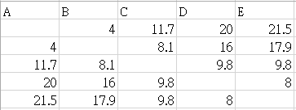

Homework 2
Example:
input
…
output

Slide 11
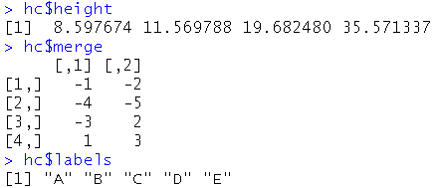
Homework 2
Step 1 :
Using the information (height, merge, labels) to separate clusters.
Step 2 :
Calculate the Silhouette coefficient of every object

Slide 12
Homework 2
Score :
Five test cases
Separate clusters (10%)
Calculate the Silhouette coefficient (10%)

Slide 13
Deadline
Deadline
2016/05/03 23:59
Submit
Portal
Filename
s+SID_HW2.r
e.g : s1001234_HW2.r

Slide 14
Bonus
Bonus 1 : Top 10% submit
Note : Score > 90
Bonus 2 : Provide Data
mailto: tinin@saturn.yzu.edu.tw

